Slide 1
Module V
Software Configuration Management: Using version control, Managing dependencies, Managing software configuration, Managing build and deployment environments.
Continuous Integration: Prerequisites for continuous integration, Essential practices.
Continuous Delivery: Principles of Software delivery, Introduction and concepts.
Build and deployment automation, Learn to use Ansible for configuration management.
Test automation (as part of continuous integration), Learn to set up test automation cases using Robot Framework.

Slide 2
Books refered
Glenford J. Myers, et. al., The Art of Software Testing, Wiley.
Lee Copeland, A Practitioner's Guide to Software Test Design, Artech House Publishers.
Jez Humble and David Farley, Continuous Delivery: Reliable Software Releases through Build, Test, and Deployment Automation, Pearson Education.
What is CI/CD? https://www.redhat.com/en/topics/devops/what-is-ci-cd Retrieved 8 July 2020.

Slide 3
Configuration Management
Other word for version control.
Configuration management refers to the process by which all artifacts relevant to your project, and the relationships between them, are stored, retrieved, uniquely identified, and modified.
How you manage all of the changes that happen within your project.
It records the evolution of your systems and applications.
It will also govern how your team collaborates.

Slide 4
Continues..
If you have a good configuration management strategy, you should be able to answer “yes” to all of the following questions:
Can I exactly reproduce any of my environments, including the version of the operating system, its patch level, the network configuration, the software stack, the applications deployed into it, and their configuration?
Can I easily make an incremental change to any of these individual items and deploy the change to any, and all, of my environments?
Can I easily see each change that occurred to a particular environment and trace it back to see exactly what the change was, who made it, and when they made it?
Can I satisfy all of the compliance regulations that I am subject to?
Is it easy for every member of the team to get the information they need, and to make the changes they need to make? Or does the strategy get in the way of efficient delivery, leading to increased cycle time and reduced feedback?

Slide 5
Continues..
Software Configuration Management(SCM) is a process to systematically manage, organize, and control the changes in the documents, codes, and other entities during the Software Development Life Cycle.
The primary goal is to increase productivity with minimal mistakes.
The objective is to maintain software integrity and traceability throughout the software life cycle.

Slide 6
Advantages
Getting the prerequisites in place to manage your application’s build, deploy, test, and release process- We tackle this in two parts: getting everything into version control and managing dependencies.
Managing an application’s configuration.
Configuration management of whole environments—the software, hardware, and infrastructure that an application depends upon; the principles behind environment management, from operating systems to application servers, databases, and other commercial off-the-shelf (COTS) software.

Slide 7
Continues..
Version control is a component of software configuration management.
Everything you need to build, deploy, test, and release your application should be kept in some form of versioned storage.
This includes requirement documents, test scripts, automated test cases, network configuration scripts, deployment scripts, database creation, upgrade, downgrade, and initialization scripts, application stack configuration scripts, libraries, toolchains, technical documentation, and so on.
All of this stuff should be version-controlled, and the relevant version should be identifiable for any given build.
That is, these change sets should have a single identifier, such as a build number or a version control change set number, that references every piece.

Slide 8
Using Version Control
Version control systems, also known as source control, source code management systems, or revision control systems, are a mechanism for keeping multiple versions of your files, so that when you modify a file you can still access the previous revisions.
The aim (or purpose) of a version control system is twofold: First, it retains, and provides access to, every version of every file that has ever been stored in it. Second, it allows teams that may be distributed across space and time to collaborate.

Slide 9
Continues..
Keep Absolutely Everything in Version Control :-
The objective is to have everything that can possibly change at any point in the life of the project stored in a controlled manner.
This allows you to recover an exact snapshot of the state of the entire system, from development environment to production environment, at any point in the project’s history.
It is even helpful to keep the configuration files for the development team’s development environments in version control since it makes it easy for everyone on the team to use the same settings.
Analysts should store requirements documents.
Testers should keep their test scripts and procedures in version control.
Project managers should save their release plans, progress charts, and risk logs here.
In short, every member of the team should store any document or file related to the project in version control.

Slide 10
Continues..
Check In Regularly to Trunk(main branch):-
It is important to be sure that your work, whatever it may be, is ready for the level of publicity that a check-in implies.
When a new features is developed incrementally, commit them to the trunk in version control on a regular and frequent basis.
This keeps the software working and integrated at all times.
It means that your software is always tested because your automated tests are run on trunk by the continuous integration (CI) server every time you check in.
It reduces the possibility of large merge conflicts caused by refactoring, ensures that integration problems are caught immediately when they are cheap to fix, and results in higher-quality software.

Slide 11
Continues..
Use Meaningful Commit Messages:-
Every version control system has the facility to add a description to your commit.
It is easy to omit these messages, and many people get into the bad habit of doing so.
The most important reason to write descriptive commit messages is so that, when the build breaks, you know who broke the build and why.
A commit message explaining what the person was doing when they committed that change can save you hours of debugging.

Slide 12
Managing Dependencies
The most common external dependencies within your application are the third party libraries it uses and the relationships between components or modules under development by other teams within your organization.
Managing External Libraries:- External libraries usually come in binary form, unless you’re using an interpreted language. Even with interpreted languages, external libraries are normally installed globally on your system by a package management system.

Slide 13
Continues..
It is better to keep copies of your external libraries somewhere locally.
This is essential if you have to follow compliance regulations, and it also makes getting started on a project faster.
We emphasize that your build system should always specify the exact version of the external libraries that you use.
If you don’t do this, you can’t reproduce your build.
Whether you keep external libraries in version control or not involves some trade-offs. It makes it much easier to correlate versions of your software with the versions of the libraries that were used to build them.

Slide 14
Managing Software Configuration
Configuration is one of the three key parts that comprise an application, along with its binaries and its data.
Configuration information can be used to change the behaviour of software at build time, deploy time and run time.
Delivery teams need to consider carefully what configuration options should be available, how to manage them throughout the application’s life, and how to ensure that configuration is managed consistently across components, applications, and technologies.
you should treat the configuration of your system in the same way you treat your code: Make it subject to proper management and testing.

Slide 15
Continues..
Configuration and Flexibility
Everyone wants flexible software. But flexibility usually comes at a cost.
Most applications they are designed for a specific purpose, but within the bounds of that purpose they will usually have some ways in which their behaviour can be modified.
The desire to achieve flexibility may lead to the common antipattern of “ultimate configurability” which is, all too frequently, stated as a requirement for software projects.
It is at best unhelpful, and at worst, this one requirement can kill a project.

Slide 16
Continues..
Configurable software is not always the cheaper solution it appears to be. It’s almost always better to focus on delivering the high-value functionality with little configuration and then add configuration options later when necessary.
Most configuration information is free-form and untested.
Configuration is not inherently evil. But it needs to be managed carefully and consistently.
Modern computer languages have evolved all sorts of characteristics and techniques to help them reduce errors.

Slide 17
Continues..
In most cases, these protections do not exist for configuration information, and more often than not there are not even any tests in place to verify that your software has been configured correctly in testing and production environments.
Deployment smoke tests are one way to mitigate this problem and should always be used.
Smoke tests are a subset of test cases that cover the most important functionality of a component or system, used to aid assessment of whether main functions of the software appear to work correctly. Smoke testing is also done by testers before accepting a build for further testing.

Slide 18
Continues..

Slide 19
Continues..
Whatever mechanism you choose, it is recommended that, as far as practically possible, you should try and supply all configuration information for all the applications and environments in your organization through the same mechanism.
This isn’t always possible, but when it is, it means that there is a single source of configuration to change, manage, version-control, and override (if necessary).
In organizations where this practice isn’t followed, people regularly spend hours tracking down the source of some particular setting in one of their environments.

Slide 20
Managing Build and Deployment Environments
No application is an island.
Every application depends on hardware, software, infrastructure, and external systems in order to work – referred as application’s environment.
The principle to bear in mind when managing the environment that your application runs in is that the configuration of that environment is as important as the configuration of the application.
For example, if your application depends on a messaging bus, the bus needs to be configured correctly or the application will not work.

Slide 21
Continues..
The problems can be summed up as follows:
One small change can break the whole application or severely degrade its performance.
Once it is broken, finding the problem and fixing it takes an indeterminate amount of time and requires senior personnel.
It is extremely difficult to precisely reproduce manually configured environments for testing purposes.
The collection of configuration information is very large.
It is difficult to maintain such environments without the configuration, and hence behaviour, of different nodes drifting apart.

Slide 22
Continues..
In order to reduce the cost and risk of managing environments, it is essential to turn our environments into mass-produced objects whose creation is repeatable and takes a predictable amount of time.
The key to managing environments is to make their creation a fully automated process.
It should always be cheaper to create a new environment than to repair an old one.

Slide 23
Continues..
Being able to reproduce your environments is essential for several reasons:-
It removes the problem of having random pieces of infrastructure around whose configuration is only understood by somebody who has left the organization and cannot be reached. When such things stop working, you can usually assume a significant downtime. This is a large and unnecessary risk.
Fixing one of your environments can take many hours. It is always better to be able to rebuild it in a predictable amount of time so as to get back to a known good state.
It is essential to be able to create copies of production environments for testing purposes. In terms of software configuration, testing environments should be exact replicas of the production ones, so configuration problems can be found early.

Slide 24
Continues..
The kinds of environment configuration information you should be concerned about are:
The various operating systems in your environment, including their versions, patch levels, and configuration settings.
The additional software packages that need to be installed on each environment to support your application, including their versions and configuration.
The networking topology required for your application to work.
Any external services that your application depends upon, including their versions and configuration.
Any data or other state that is present in them (for example, production databases)

Slide 25
Continues..
There are two principles that form the basis of an effective configuration management strategy:
Keep binary files independent from configuration information, and
keep all configuration information in one place.
Applying these fundamentals to every part of your system will pave the way to the point where creating new environments, upgrading parts of your system, and rolling out new configurations without making your system unavailable becomes a simple, automated process.

Slide 26
Continues..
When evaluating third-party products and services, start by asking the following questions:
Can we deploy it?
Can we version its configuration effectively?
How will it fit into our automated deployment strategy?

Slide 27
Continues..
An environment that is in a properly deployed state is known as a baseline in configuration management terminology.
Your automated environment provisioning system should be able to establish, or re-establish, any given baseline that has existed in the recent history of your project.
Any time you change any aspect of the host environment of your applications, you should store the change, creating a new version of the baseline and associating that version of the application with the new version of the baseline.
This ensures that the next time that you deploy the application or create a new environment, it will include the change.

Slide 28
Continues..
You should treat your environment the same way you treat your code—changing it incrementally and checking the changes into version control.
Every change should be tested to ensure that it doesn’t break any of the applications that run in the new version of the environment.
Integration is often a very painful process.
If this is true on your project, integrate every time somebody checks in, and do it from the start of the project.
If testing is a painful process that occurs just before release, don’t do it at the end. Instead, do it continually from the beginning of the project.

Slide 29
Benefits of Configuration Management
Allowing configuration to be version controlled
Detecting and correcting configuration drift
Treating infrastructure as flexible resource
Facilitating automation
Enabling automated scale-up and scale-out
Providing environment consistency

Slide 30
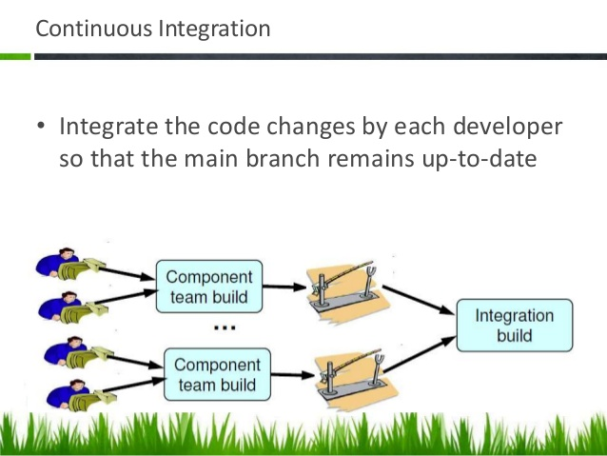
Continuous Integration (CI)
CI is the practice of merging all developer working copies to a shared code line several times a day, and validating each integration with an automated build.
Also, CI is often defined as having a build with unit tests that executes at every commit/check-in to version control.

Slide 31
Benefits
Improving code quality based on rapid feedback
Triggering for automated testing for every code change
Better managing technical debt and conducting code analysis
Reducing long, difficult and bug-inducing merges
Increasing confidence in code long before production

Slide 32
Continues..
Continuous integration represents a paradigm shift.
Without continuous integration, your software is broken until somebody proves it works, usually during a testing or integration stage.
With continuous integration, your software is proven to work with every new change—and you know the moment it breaks and can fix it immediately.
The teams that use continuous integration effectively are able to deliver software much faster, and with fewer bugs, than teams that do not.
Bugs are caught much earlier in the delivery process when they are cheaper to fix, providing significant cost and time savings.
Hence we consider it an essential practice for professional teams, perhaps as important as using version control.

Slide 33
Implementing Continuous Integration
There are some prerequisites for implementing CI.
There are some essential practices which have to be followed the teams.
There are three things that you need before you can start with continuous integration.
Version Control:- Everything in your project must be checked in to a single version control repository: code, tests, database scripts, build and deployment scripts, and anything else needed to create, install, run, and test your application.

Slide 34
Continues..
An Automated Build:- You must be able to start your build from the command line. You can start off with a command-line program that tells your IDE to build your software and then runs your tests, or it can be a complex collection of multistage build scripts that call one another. Whatever the mechanism, it must be possible for either a person or a computer to run your build, test, and deployment process in an automated fashion via the command line
Agreement of the Team:- Continuous integration is a practice, not a tool. It requires a degree of commitment and discipline from your development team. You need everyone to check in small incremental changes frequently to mainline and agree that the highest priority task on the project is to fix any change that breaks the application. If people don’t adopt the discipline necessary for it to work, your attempts at continuous integration will not lead to the improvement in quality that you hope for.

Slide 35
A Basic Continuous Integration System
Continuous Integration is a practice, not a tool.
CI tools these days are extremely simple to install and get running.
Once you have your CI tool of choice installed it should be possible to get started in just a few minutes by telling your tool where to find your source control repository, what script to run in order to compile, and run the automated commit tests for your application, and how to tell you if the last set of changes broke the software.
The next step is for everybody to start using the CI server.

Slide 36
Continues..
Here is a simple process to follow.
Check to see if the build is already running. If so, wait for it to finish. If it fails, you’ll need to work with the rest of the team to make it green before you check in.
Once it has finished and the tests have passed, update the code in your development environment from this version in the version control repository to get any updates.
Run the build script and tests on your development machine to make sure that everything still works correctly on your computer, or alternatively use your CI tool’s personal build feature.

Slide 37
Continues..
If your local build passes, check your code into version control.
Wait for your CI tool to run the build with your changes.
If it fails, stop what you’re doing and fix the problem immediately on your development machine—go to step 3.
If the build passes, rejoice and move on to your next task.
If everybody on the team follows these simple steps every time they commit any change, you will know that your software works on any box with the same configuration as the CI box at all times.

Slide 38
Prerequisites for Continuous Integration
For CI to be effective, the following practices will need to be in place before you start…
Check In Regularly
Create a Comprehensive Automated Test Suite
Keep the Build and Test Process Short
Managing Your Development Workspace
Using Continuous Integration Software

Slide 39
Continues..
Check In Regularly
The most important practice for continuous integration to work properly is frequent check-ins to trunk or mainline.
Checking in your code at least a couple of times a day.
Checking in regularly brings lots of other benefits:-
It makes your changes smaller and thus less likely to break the build. It means you have a recent known good version of the software to revert to when you make a mistake or go down the wrong path.

Slide 40
Continues..
It helps you to be more disciplined about your refactoring and stick to small changes that preserve behaviour.
It helps to ensure that changes altering a lot of files are less likely to conflict with other people’s work.
It allows developers to be more explorative, trying out ideas and discarding them by reverting back to the last committed version.
It forces you to take regular breaks and stretch your muscles.
It also means that if something catastrophic happens (such as deleting something by mistake) you haven’t lost too much work.

Slide 41
Continues..
Create a Comprehensive Automated Test Suite
If you don’t have a comprehensive suite of automated tests, a passing build only means that the application could be compiled and assembled.
While for some teams this is a big step, it’s essential to have some level of automated testing to provide confidence that your application is actually working.
There are many kinds of automated tests. However, there are three kinds of tests that runs from continuous integration build: unit tests, component tests, and acceptance tests.
These three sets of tests, combined, should provide an extremely high level of confidence that any introduced change has not broken existing functionality.

Slide 42
Continues..
Unit tests are written to test the behaviour of small pieces of your application in isolation.
They can usually be run without starting the whole application.
They do not hit the database (if your application has one), the filesystem, or the network.
They don’t require your application to be running in a production-like environment.
Unit tests should run very fast—your whole suite, even for a large application, should be able to run in under ten minutes.
Component tests test the behavior of several components of your application.
Like unit tests, they don’t always require starting the whole application.
They may hit the database, the filesystem, or other systems (which may be stubbed out).
Component tests typically take longer to run.

Slide 43
Continues..
Acceptance tests test that the application meets the acceptance criteria decided by the business, including both the functionality provided by the application and its characteristics such as capacity, availability, security, and so on.
Acceptance tests are best written in such a way that they run against the whole application in a production-like environment.
Acceptance tests can take a long time to run—it’s not unheard of for an acceptance test suite to take more than a day to run sequentially.

Slide 44
Continues..
Keep the Build and Test Process Short
If it takes too long to build the code and run the unit tests, you will run into the following problems:
People will stop doing a full build and running the tests before they check-in. You will start to get more failing builds.
The continuous integration process will take so long that multiple commits will have taken place by the time you can run the build again, so you won’t know which check-in broke the build.
People will check in less often because they have to sit around for ages waiting for the software to build and the tests to run.
Ideally, the compile and test process that you run prior to check-in and on your CI server should take no more than a few minutes.
There are a number of techniques that you can use to reduce the build time.
The first thing to consider is making your tests run faster.
XUnit-type tools, such as JUnit and NUnit, provide a breakdown of how long each test took in their output.

Slide 45
Managing Your Development Workspace
It is important for developers’ productivity and sanity that their development environment is carefully managed.
Developers should always work from a knowngood starting point when they begin a fresh piece of work.
They should be able to run the build, execute the automated tests, and deploy the application in an environment under their control.
This should be on their own local machine.

Slide 46
Continue..
Only in exceptional circumstances should you use shared environments for development.
Running the application in a local development environment should use the same automated processes that are used in the continuous integration and testing environments and ultimately in production.
The first prerequisite to achieve this is careful configuration management, not just of source code, but also of test data, database scripts, build scripts, and deployment scripts.
The second step is configuration management of third-party dependencies, libraries, and components.
The final step is to make sure that the automated tests, including smoke tests, can be run on developer machines.

Slide 47
Continues..
Using Continuous Integration Software
There are many products on the market that can provide the infrastructure for your automated build and test process.
The most basic functionality of continuous integration software is to poll your version control system to see if any commits have occurred and, if so, check out the latest version of the software, run your build script to compile the software, run the tests, and then notify you of the results.
At heart, continuous integration server software has two components.
The first is a long-running process which can execute a simple workflow at regular intervals.
The second provides a view of the results of the processes that have been run, notifies you of the success or failure of your build and test runs, and provides access to test reports, installers, and so on.

Slide 48
Continues..
Most CI servers include a web server that shows you a list of builds that have run and allows you to look at the reports that define the success or failure of each build.
This sequence of build instructions should culminate in the production and storage of the resulting artifacts such as binaries or installation packages, so that testers and clients can easily download the latest good version of the software.
Most CI servers are configurable using a web interface or through simple scripts.
Today’s advanced CI servers can distribute work across a build grid, manage the builds and dependencies of collections of collaborating components, report directly into your project management tracking system, and do lots of other useful things.

Slide 49
Essential Practices
Continuous integration is a practice, not a tool, and it depends upon discipline to make it effective.
Keeping a continuous integration system operating, particularly when dealing with large and complex CI systems, requires a significant degree of discipline from the development team as a whole.
The objective of CI system is to ensure that software is working, all of the time.
There are few practices that should be enforced on teams to ensure that the software is working, all of the time.
These practices that are optional but desirable, but those listed here are mandatory for continuous integration to work.

Slide 50
Continues..
Don’t Check In on a Broken Build:-
If the build breaks, the developers responsible are waiting to fix it. They identify the cause of the breakage as soon as possible and fix it. work out what caused the breakage and fix it immediately. When this rule is broken, it inevitably takes much longer for the build to be fixed. People get used to seeing the build broken, and very quickly you get into a situation where the build stays broken all of the time.
Always Run All Commit Tests Locally before Committing, or Get Your CI Server to Do It for You:-
Running the commit tests locally is a sanity check before committing to the action. It is also a way to ensure that what we believe to work actually does.

Slide 51
Continues..
There are two reasons for this approach:
Other people may have checked in before your last update from version control, and the combination of your new changes and theirs might cause tests to fail. If you check out and run the commit tests locally, you will identify this problem without breaking the build.
A common source of errors on check-in is to forget to add some new artefact to the repository. If you follow this procedure, and your local build passes, and then your CI management system fails the commit stage, you know that it is either because someone checked in in the meantime, or because you forgot to add the new class or configuration file that you have just been working on into the version control system.

Slide 52
Continues..
Wait for Commit Tests to Pass before Moving On:-
The CI system is a shared resource for the team. When a team is using CI effectively, any breakage of the build is a minor stumbling block for the team and project as a whole. Build breakages are a normal and expected part of the process. Aim is to find errors and eliminate them as quickly as possible, without expecting perfection and zero errors. If the commit succeeds, the developers can move on to their next task. If it fails, they are at hand to start determining the natureof the problem and fixing it.
Never Go Home on a Broken Build:-
It is 5:30 P.M. on Friday, you have just committed your changes. The build has broken. You have three options. You can resign yourself to the fact that you will be leaving late, and try to fix it. You can revert your changes and return to your check-in attempt next week. Or you can leave now and leave the build broken. Just to be absolutely clear, we are not recommending that you stay late to fix the build after working hours. Rather, we recommend that you check in regularly and early enough to give yourself time to deal with problems should they occur.

Slide 53
Continues..
Always Be Prepared to Revert to the Previous Revision:-
we all make mistakes, so we expect that everyone will break the build from time to time. Whatever our reaction to a failed commit stage, it is important that we get everything working again quickly. If we can’t fix the problem quickly, for whatever reason, we should revert to the previous change-set held in revision control and remedy the problem in our local environment. Airplane pilots are taught that every time they land, they should assume that something will go wrong, so they should be ready to abort the landing attempt and “go around” to make another try. Use the same mindset when checking in.
Time-Box Fixing before Reverting:-
Establish a team rule: When the build breaks on check-in, try to fix it for ten minutes. If, after ten minutes, you aren’t finished with the solution, revert to the previous version from your version control system.
Don’t Comment Out Failing Tests:-
Once you begin to enforce the previous rule, the result is often that developers comment out failing tests in order to get their changes checked in. This impulse is understandable, but wrong. When tests that have been passing for a while begin to fail, it can be hard to work out why. Commenting out tests that fail should always be a last resort, very rarely and reluctantly used, unless you are disciplined enough to fix it right away. It is OK to very occasionally comment out a test pending either some serious development work that needs to be scheduled or some extended discussions with the customer.

Slide 54
Continues..
Take Responsibility for All Breakages That Result from Your Changes :-
If you commit a change and all the tests you wrote pass, but others break, the build is still broken. Usually this means that you have introduced a regression bug into the application. It is your responsibility—because you made the change—to fix all tests that are not passing as a result of your changes.
To do CI effectively, everybody needs access to the whole codebase. If for some reasons you are forced into a situation where access to code cannot be shared with the whole team, you can manage around it through good collaboration with the people who have the necessary access. However, this is very much a second-best, and you should work hard to get such restrictions removed.

Slide 55
Test-Driven Development
The idea is that when developing a new piece of functionality or fixing a bug, developers first create a test that is an executable specification of the expected behaviour of the code to be written. Not only do these tests drive the application’s design, they then serve both as regression tests and as documentation of the code and the application’s expected behavior.

Slide 56
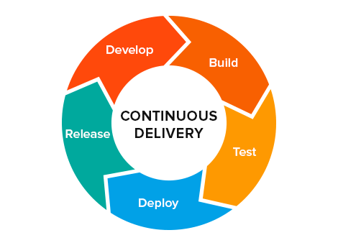
Continues Delivery

Slide 57
Continues..
Continuous Integration usually refers to integrating, building, and testing code within the development environment. Continuous Delivery builds on this, dealing with the final stages required for production deployment.
Continuous Delivery just means that you are able to do frequent deployments but may choose not to do it, usually due to businesses preferring a slower rate of deployment. In order to do Continuous Deployment you must be doing Continuous Delivery.
Continuous Deployment means that every change goes through the pipeline and automatically gets put into production, resulting in many production deployments every day.

Slide 58
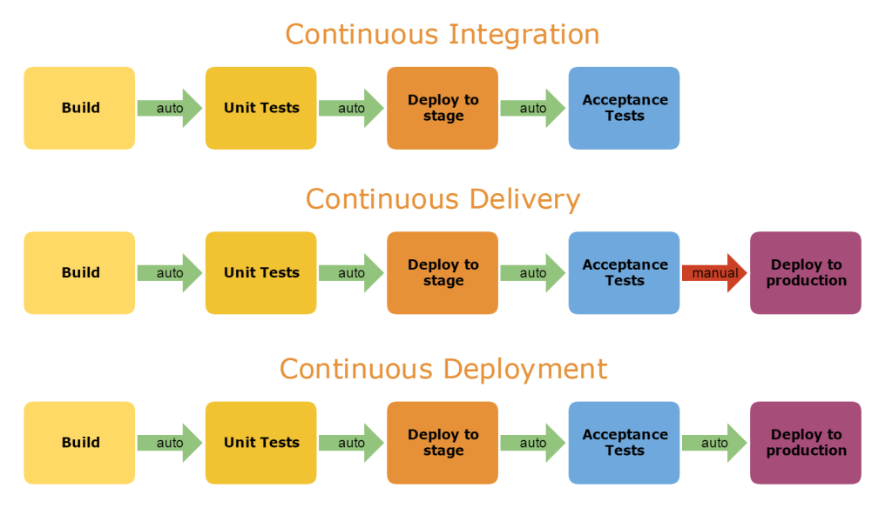
Continues..

Slide 59
Continuous Delivery
Continuous Delivery is a software engineering approach in which teams produce software in short cycles, ensuring that software can be reliably released at any time.
It aims to build, test and release software faster and more frequently.
It reduces the cost, time, and risk of delivering changes by allowing for more incremental updates to production.

Slide 60
Continues..
Continuous delivery is a software development practice where code changes are automatically prepared for a release to production.
Continuous delivery lets developers automate testing beyond just unit tests so they can verify application updates across multiple dimensions before deploying to customers.
In practice, continuous delivery focuses on automated deployment pipeline. This may have one or more manual approval gates prior to reaching production.
Continuous delivery provides many benefits, including:
It encourages Infrastructure as Code and Configuration as Code.
It enables automated testing throughout the pipeline.
It provides visibility and fast feedback cycles.
It makes going to production a low stress activity.

Slide 61
Continues..
A deployment pipeline is an automated implementation of your application’s build, deploy, test, and release process.
Every organization will have differences in the implementation of their deployment pipelines, depending on their value stream for releasing software, but the principles that govern them do not vary.
An example of a deployment pipeline is given below:-

Slide 62
Continues..
The way the deployment pipeline works is as follows:-
Every change that is made to an application’s configuration, source code, environment, or data, triggers the creation of a new instance of the pipeline.
One of the first steps in the pipeline is to create binaries and installers.
The rest of the pipeline runs a series of tests on the binaries to prove that they can be released.
Each test that the release candidate passes gives us more confidence that this particular combination of binary code, configuration information, environment, and data will work.
If the release candidate passes all the tests, it can be released.

Slide 63
Continues..
The aim of the deployment pipeline is threefold.
First, it makes every part of the process of building, deploying, testing, and releasing software visible to everybody involved, aiding collaboration.
Second, it improves feedback so that problems are identified, and so resolved, as early in the process as possible.
Finally, it enables teams to deploy and release any version of their software to any environment at will through a fully automated process.
Our goal as software professionals is to deliver useful, working software to users as quickly as possible.
Speed is essential because there is an opportunity cost associated with not delivering software. (You can only start to get a return on your investment once your software is released.)
Find ways to reduce cycle time :-- the time it takes from deciding to make a change, whether a bugfix or a feature, to having it available to users.

Slide 64
Continues..
Delivering fast is also important because it allows you to verify whether your features and bug fixes really are useful.
An important part of usefulness is quality. Our software should be fit for its purpose.
our goal should always be to deliver software of sufficient quality to bring value to its users.
So while it is important to deliver our software as quickly as possible, it is essential to maintain an appropriate level of quality.
Hence , now our goal actually is to find ways to deliver high-quality, valuable software in an efficient, fast, and reliable manner.
In order to achieve these goals—low cycle time and high quality—we need to make frequent, automated releases of our software.
Automated:- If the build, deploy, test, and release process is not automated, it is not repeatable. Every time it is done, it will be different, because of changes in the software, the configuration of the system, the environments, and the release process. Since the steps are manual, they are error-prone, and there is no way to review exactly what was done.

Slide 65
Continues..
Frequent. If releases are frequent, the delta between releases will be small. This significantly reduces the risk associated with releasing and makes it much easier to roll back. Frequent releases also lead to faster feedback.
Feedback is essential to frequent, automated releases. There are three criteria for feedback to be useful.
Any change needs to trigger the feedback process.
The feedback must be delivered as soon as possible.
The delivery team must receive feedback and then act on it.

Slide 66
Continues..
Every Change Should Trigger the Feedback Process
A working software application can be usefully decomposed into four components: executable code, configuration, host environment, and data.
If any of them changes, it can lead to a change in the behavior of the application. Therefore we need to keep all four of these components under control and ensure that a change in any one of them is verified.
The Feedback Must Be Received as Soon as Possible
The key to fast feedback is automation.
If you have manual processes, you are dependent on people to get the job done. People take longer, they introduce errors, and they are not auditable. Moreover performing manual build, test, and deployment processes is boring and repetitive.

Slide 67
Continues..
The Delivery Team Must Receive Feedback and Then Act on It
It is essential that everybody (developers, testers, operations staff, database administrators, infrastructure specialists, and managers) involved in the process of delivering software is involved in the feedback process.
If people in these roles do not work together on a day-to-day basis, it is essential that they meet frequently and work to improve the process of delivering software.
A process based on continuous improvement is essential to the rapid delivery of quality software.
Iterative processes help this kind of activity—at least once per iteration a retrospective meeting is held where everybody discusses how to improve the delivery process for the next iteration.

Slide 68
Continues..
Being able to react to feedback also means broadcasting information. Using big, visible dashboards (which need not be electronic) and other notification mechanisms is central to ensuring that feedback is fed-back and makes the final step into someone’s head.
Finally, feedback is no good unless it is acted upon. This requires discipline and planning.
When something needs doing, it is the responsibility of the whole team to stop what they are doing and decide on a course of action. Only once this is done should the team carry on with their work.

Slide 69
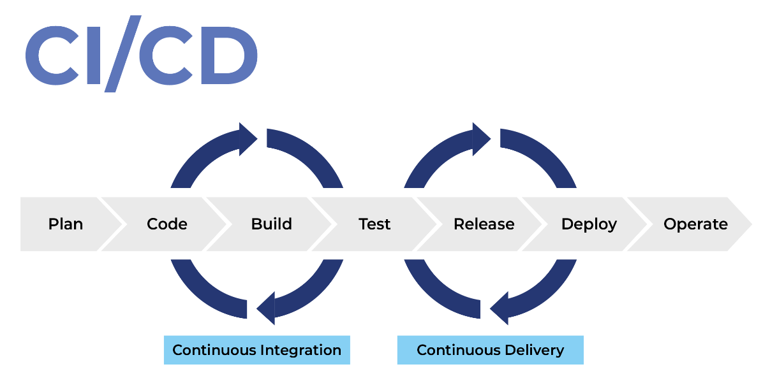
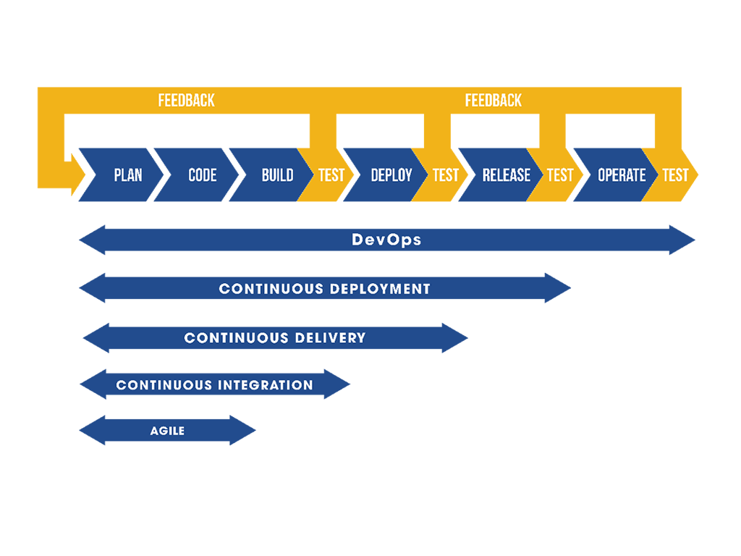
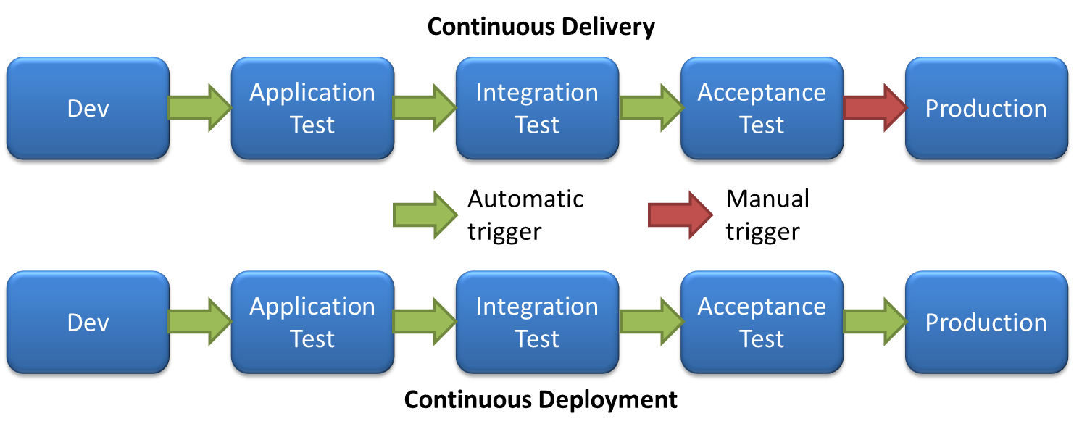
Continues..

Slide 70
Principles of Software Delivery
Create a Repeatable, Reliable Process for Releasing Software:-
Releasing software should be easy. It should be as simple as pressing a button.
It should be easy because you have tested every single part of the release process hundreds of times before.
The repeatability and reliability derive from two principles: automate almost everything, and keep everything you need to build, deploy, test, and release your application in version control.
Deploying software ultimately involves three things:
Provisioning and managing the environment in which your application will run (hardware configuration, software, infrastructure, and external services).
Installing the correct version of your application into it.
Configuring your application, including any data or state it requires.

Slide 71
Continues..
Automate Almost Everything
Most development teams don’t automate their release process because it seems such a daunting task.
It’s easier just to do things manually. Perhaps that is true the first time they perform a step in the process, but it is certainly not true by the time they perform that step for the tenth time.
Automation is a prerequisite for the deployment pipeline, because it is only through automation that we can guarantee that people will get what they need at the push of a button.
You don’t need to automate everything at once. You can, and should, automate gradually over time.
There are some things it is impossible to automate.(eg:- Demonstrations of working software to representatives of your user community cannot be performed by computers.) However, the list of things that cannot be automated is much smaller than many people think.

Slide 72
Continues..
Keep Everything in Version Control
Everything you need to build, deploy, test, and release your application should be kept in some form of versioned storage.
This includes requirement documents, test scripts, automated test cases, network configuration scripts, deployment scripts, database creation, upgrade, downgrade, and initialization scripts, application stack configuration scripts, libraries, toolchains, technical documentation, and so on.
All of this stuff should be version-controlled, and the relevant version should be identifiable for any given build.
That is, these change sets should have a single identifier, such as a build number or a version control change set number, that references every piece.

Slide 73
Continues..
If It Hurts, Do It More Frequently, and Bring the Pain Forward
Integration is often a very painful process. If this is true on your project, integrate every time somebody checks in, and do it from the start of the project.
If testing is a painful process that occurs just before release, don’t do it at the end. Instead, do it continually from the beginning of the project.
If releasing software is painful, aim to release it every time somebody checks in a change that passes all the automated tests.
If you can’t release it to real users upon every change, release it to a production-like environment upon every check-in.
If creating application documentation is painful, do it as you develop new features instead of leaving it to the end.

Slide 74
Continues..
Build Quality In
“Build quality in” “Bring the pain forward” --catch defects as early in the delivery process as possible and the next step is to fix them.
Delivery teams must be disciplined about fixing defects as soon as they are found. (Eg:- A fire alarm is useless if everybody ignores it.)
Done Means Released
A feature is only done when it is delivering value to users.
For some agile delivery teams, “done” means released into production. This is the ideal situation for a software development project.
There is no “80% done.” Things are either done, or they are not.

Slide 75
Continues..
Everybody Is Responsible for the Delivery Process
Everybody within an organization is aligned with its goals, and people work together to help each to meet them. Ultimately the team succeeds or fails as a team, not as individuals.
If you are working in a small organization or in a relatively independent department, you may have complete control over the resources that you need to release software. If so, fantastic. If not, realizing this principle may require hard work over a long period of time to break down the barriers between the silos that isolate people in different roles.

Slide 76
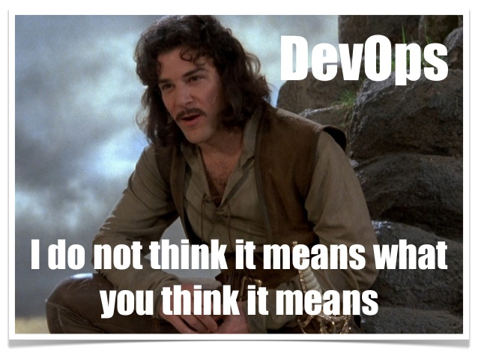
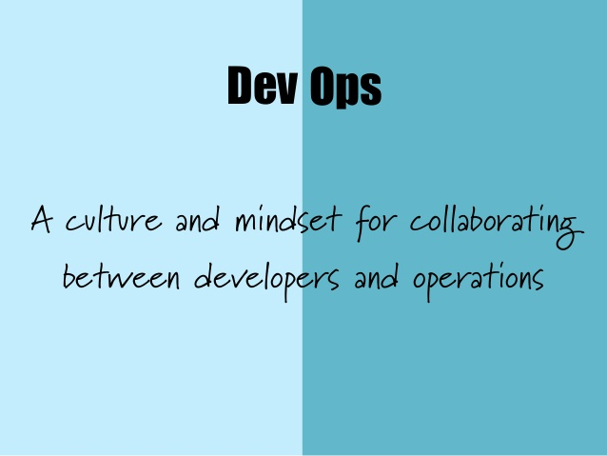
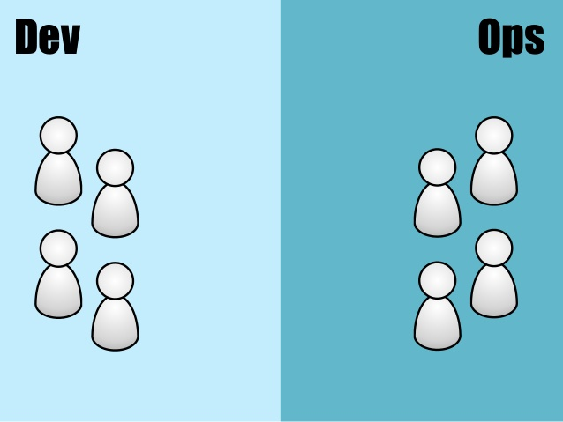
Continues..
This is one of the central principles of the DevOps movement. The DevOps movement – encouraging greater collaboration between everyone involved in software delivery in order to release valuable software faster and more reliably.

Slide 77
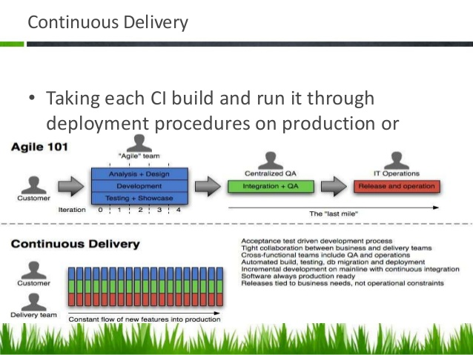
Continues..

Slide 78
Continues..
Continuous Improvement
It is worth emphasizing that the first release of an application is just the first stage in its life.
All applications evolve, and more releases will follow. It is important that your delivery process also evolves with it.
The whole team should regularly gather together and hold a retrospective on the delivery process.
This means that the team should reflect on what has gone well and what has gone badly, and discuss ideas on how to improve things.
Somebody should be nominated to own each idea and ensure that it is acted upon.Then, the next time that the team gathers, they should report back on what happened.
This is known as the Deming cycle: plan, do, study, act.

Slide 79
Build and Deployment Automation
Build automation is the process of automating the creation of a software build and the associated processes including: compiling computer source code into binary code, packaging binary code, and running automated tests.
Deployment automation is what enables you to deploy your software to testing and production environments with the push of a button. Automation is essential to reduce the risk of production deployments. It's also essential for providing fast feedback on the quality of your software by allowing teams to do comprehensive testing as soon as possible after changes.

Slide 80
Continues..
An automated deployment process has the following inputs:
Packages created by the continuous integration (CI) process (these packages should be deployable to any environment, including production).
Scripts to configure the environment, deploy the packages, and perform a deployment test (sometimes known as a smoke test).
Environment-specific configuration information.

Slide 81
Continues..
A deployment pipeline is an automated manifestation of your process for getting software from version control into the hands of your users.
That process involves building the software, followed by the progress of these builds through multiple stages of testing and deployment.
This, in turn, requires collaboration between many individuals, and perhaps several teams.
The deployment pipeline models this process, and its incarnation in a continuous integration and release management tool is what allows you to see and control the progress of each change as it moves from version control through various sets of tests and deployments to release to users.

Slide 82
Continues..

Slide 83
Continues..

Slide 84
Continues..

Slide 85
Continues..
Deployment pipeline- It is also sometimes referred to as a continuous integration pipeline, a build pipeline, a deployment production line, or a living build.
Whatever it is called, this is, fundamentally, an automated software delivery process.
This is not intended to imply that there is no human interaction with the system through this release process; rather, it ensures that error-prone and complex steps are automated, reliable, and repeatable in execution.

Slide 86
How to implement deployment automation (best practices when you design your automated deployment process)?
Use the same deployment process for every environment, including production.
Allow anyone with the necessary credentials to deploy any version of the artifact to any environment on demand in a fully automated fashion.
Use the same packages for every environment.
Make it possible to recreate the state of any environment from information stored in version control.

Slide 87
Ansible for configuration management
Ansible is the simplest solution for configuration management.
Ansible is a configuration management platform that automates storage, servers, and networking. When you use Ansible to configure these components, difficult manual tasks become repeatable and less vulnerable to error.
It's designed to be minimal in nature, consistent, secure and highly reliable, with an extremely low learning curve for administrators, developers and IT managers.

Slide 88
Continues..
Ansible consolidates resources across multiple systems to manage them from a single platform.
A configuration management system like Ansible is made up of several components. The systems that are managed can include servers, storage, networking, and software.
Ansible configurations are simple data descriptions of your infrastructure (both human-readable and machine-parsable) - ensuring everyone on your team will be able to understand the meaning of each configuration task. New team members will be able to quickly dive in and make an impact. Existing team members can get work done faster

Slide 89
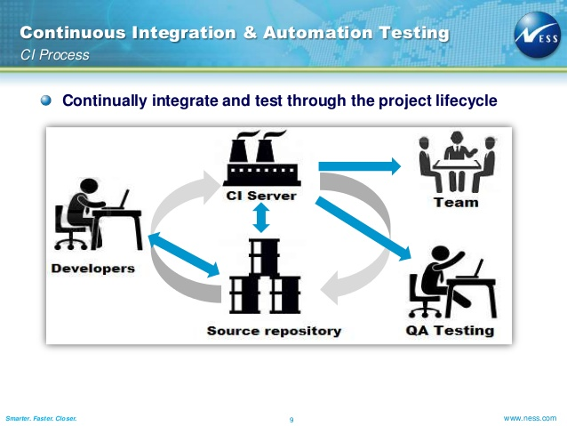
Test automation (as part of CI)
Continuous Integration (CI) is a development practice where developers integrate code into a shared repository frequently, preferably several times a day. Each integration can then be verified by an automated build and automated tests.

Slide 90
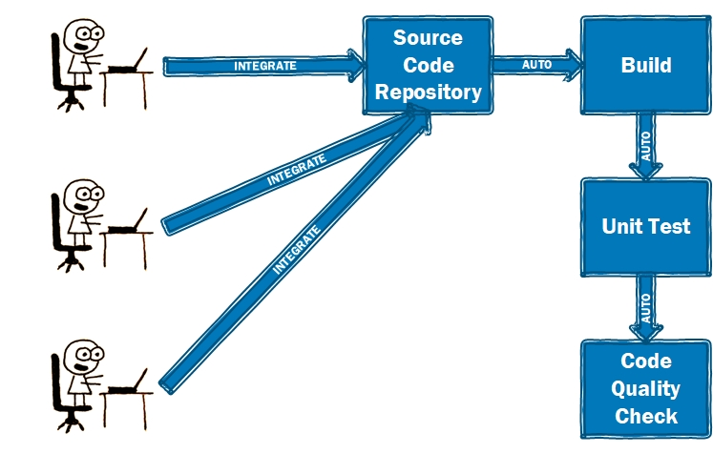
Continues..

Slide 91
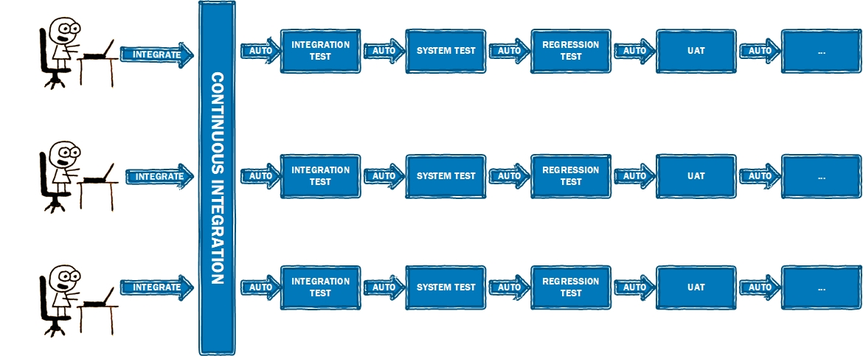
Continues..

Slide 92
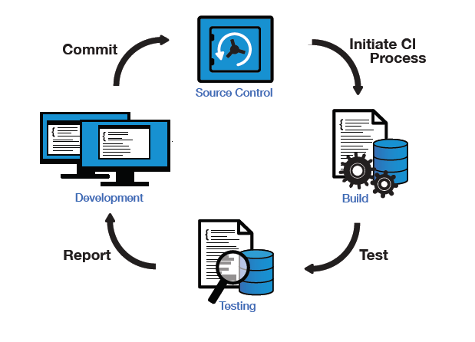
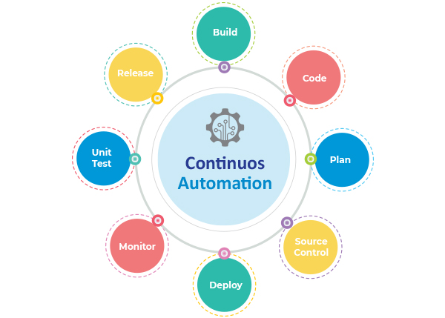
Continues..

Slide 93
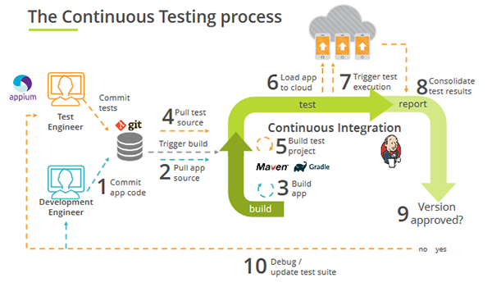
Continues..

Slide 94
Robot Framework
Robot Framework is a generic open source automation framework. It can be used for test automation and robotic process automation (RPA).
Robot Framework is a generic test automation framework for acceptance testing and acceptance test-driven development (ATDD).
It is a keyword-driven testing framework that uses tabular test data syntax.
Test cases are written using a keyword-testing methodology written in a tabular format which makes it clear and readable, and conveys the right information about the intention of the test case. For example, to open browser, the keyword used is “Open Browser”.

Slide 95
Continues..
Robot Framework is open and extensible and can be integrated with virtually any other tool to create powerful and flexible automation solutions.
Being open source also means that Robot Framework is free to use without licensing costs.
Robot Framework has easy syntax, utilizing human-readable keywords.
Its capabilities can be extended by libraries implemented with Python or Java.
Robot Framework is used very widely around the world in different domains and contexts.

Slide 96
Continues..
Robot framework consists of a set of tools, techniques and abstract rules; its job (besides allowing to write automated test cases) is simplifying the test automation process.
In practice, Robot is a modular test automation framework that has the capability to interact with 3rd party libraries and functions.
Robot is a test automation framework that uses libraries. With Robot, you can run a variety of automated tests. Selenium is a library (some call it a webdriver).

Slide 97
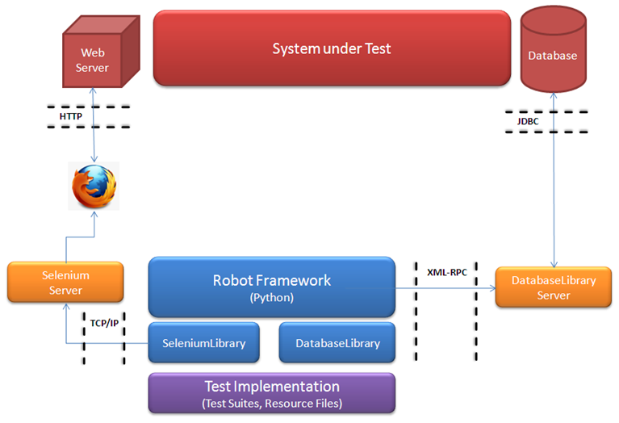
Architecture

